Slide 1
Bank DBMS Design
Student: Lina Mi
@377283
Instructor: John Russo

Slide 2
Project Proposal
Why Bank DBMS
Rapid development of economy of modern society
Fierce competition between banks
More complex requirements from customers
Manage large amount of closely related data

Slide 3
Bank DBMS
Provide more function and services.
Guarantee normal and efficient operation of the bank companies.
Provide high security of customer financial information by strict account access control
Automatic collecting data, updating database prevent bank from personal mistake and reduce the human cost, increase the benefit

Slide 4
Bank DBMS
Functions
Customer oriented services:
withdraw, deposit, transfer, loan payment, schedule loan payment
Administrative functions:
add/drop customer, open/close account
Reporting functions:
Monthly transactions list, yearly interest calculation

Slide 5
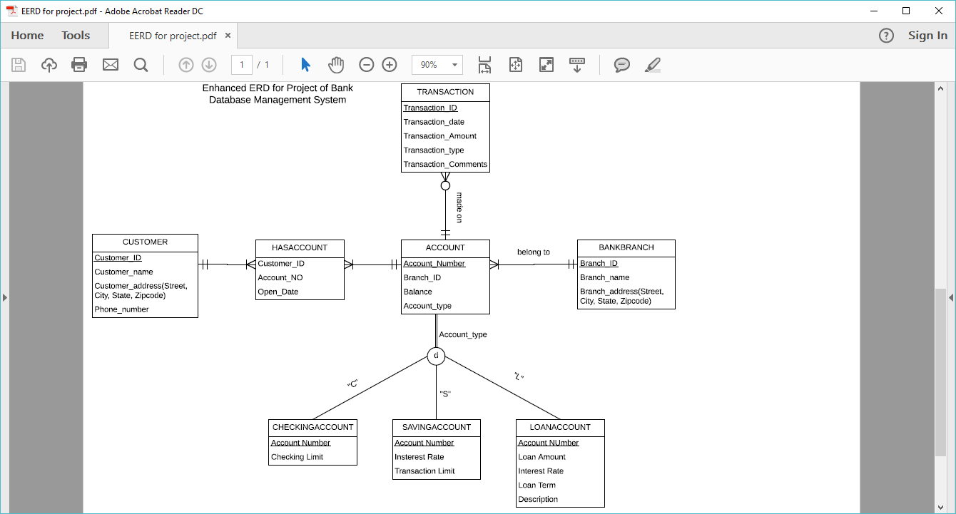
EERD of bank DBMS

Slide 6
Conceptual Design
Cust_ID | Fname | Lname | Street | City | Sate | ZipCode | Tele_No
CUSTOMER
Cust_ID | Acct_No | Open_Date
HASACCOUNT
Acct_No | Branch_ID | Balance | Acct_Type
ACCOUNT
Branch_ID | Name | Street | City | Sate | ZipCode
BANKBRANCH
Acct_No | Check_Limit
CHECKINGACCOUNT
Acct_No | Interest_Rate | Trans_Limit
SAVINGACCOUNT
Acct_No | Loan_Amt | Interest_Rate | Term | Description
LOANACCOUNT
TRANSACTION
Trans_ID | Acct_No | Trans_Amnt | Trans_type | Trans_Date | Trans_Comts

Slide 7
Physical Design
Customer table:
Fields definition
Cust_ID | Fname | Lname | Street | City | Sate | ZipCode | Tele_No
Fields | Data Type | Range of value | Constrains
Cust_ID | Int | 8 | Primary key, Not null,
Lname | Varchar | 25 | Not null
Fname | Varchar | 25 | Not null
Street | Varchar | 30
City | Varchar | 20
State | Varchar | 2
Zipcode | Varchar | 10
Tele_No | Varchar | 14

Slide 8
Physical Design
HasAccount table:
Fields definition
Cust_ID | Acct_No | Open_Date
Fields | Data Type | Range of value | Constrains
Cust_ID | Int | 8 | Primary Key, not null, reference to CUSTOMER(Cust_ID)
Acct_no | Int | 8 | Primary Key, not null, reference to ACCOUNT(Acct_NO)
Open_Date | Date |  | Default value: current date

Slide 9
Physical Design
Account table:
Fields definition
Acct_No | Balance | Branch_ID | Acct_Type
Fields | Data Type | Range of value | Constrains
Acct_No | Int | 8 | Primary Key, not null
Balance | Numeric | 10 with 2 decimal digit | Default value:0.00
Branch_ID | Int | 5 | Foreign Key, reference to Table Branch(Branch_ID)
Acct_Type | Varchar | 2 | Not null, check in {‘C’,’S’,’L’}

Slide 10
Physical Design
BankBranch table:
Fields definition
Branch_ID | Name | Street | City | State | Zipcode
Fields | Data Type | Range of value | Constrains
Branch_ID | Int | 5 | Primary Key, not null
Name | Varchar | 25 | Not null
Street | Varchar | 30
City | Varchar | 20
State | Varchar | 2
Zipcode | Varchar | 14

Slide 11
Physical Design
CheckingAccount table:
Fields definition
Acct_No | Check_Limit
Fields | Data Type | Range of value | Constrains
Acct_No | Int | 8 | Primary Key, not null
Check_Limit | Numeric | 10 with 2decimal digits | Default value:0.00

Slide 12
Physical Design
SavingAccount table:
Fields definition
Acct_No | Interest_Rate | Trans_Limit
Fields | Data Type | Range of value | Constrains
Acct_No | Int | 8 | Primary Key, not null, foreign key, refere to table Account(Acct_No)
Insterest_Rate | Numeric | 6 with 2decimal digits | Default value:0.00%
Trans_Limit | Int | 2 | Default value: 0

Slide 13
Physical Design
LoanAccount table:
Fields definition
Acct_No | Loan_Amt | Interest_Rate | Term | Loan_Description
Fields | Data Type | Range of value | Constrains
Acct_No | Int | 8 | Primary Key, not null
Loan_Amt | Numeric | 15 with 2 decimal digits | Default value: 0.00
Term | Numeric | 5 with 1 decimal digits | Default value:0.0
Interest_Rate | Numeric | 6 with 2 decimal digits | Default value:0.00
Loan_description | Varchar | 40

Slide 14
Physical Design
Transaction table:
Fields definition
Trans_ID | Acct_No | Trans_Date | Trans_Type | Trans_Amnt | Trans_Comts
Fields | Data Type | Range of value | Constrains
Trans_ID | Int | 8 | Primary key, not null
Acct_No | Int | 8 | Foreign key, reference table Aaccount(Acct_No), not null
Trans_Date | Date |  | Default value: current date
Trans_Type | Varchar | 10 | Check in{‘Transfer’, ‘Deposit’,’Withdraw’}
Trans_Amnt | Numberic | 8 with 2 decimal digits | Defualt value:0.00
Trans_Comts | Varchar | 40

Slide 15
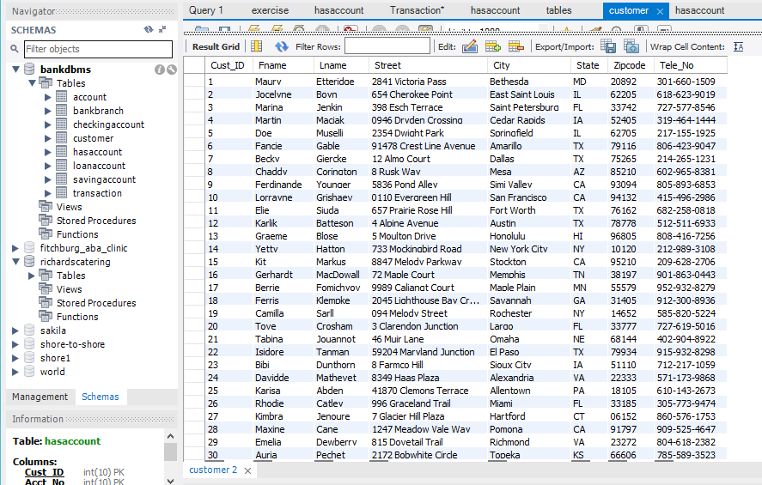
Drop customer
Query: delete from customer where Fname='Auria' and Lname='Pechet';

Slide 16
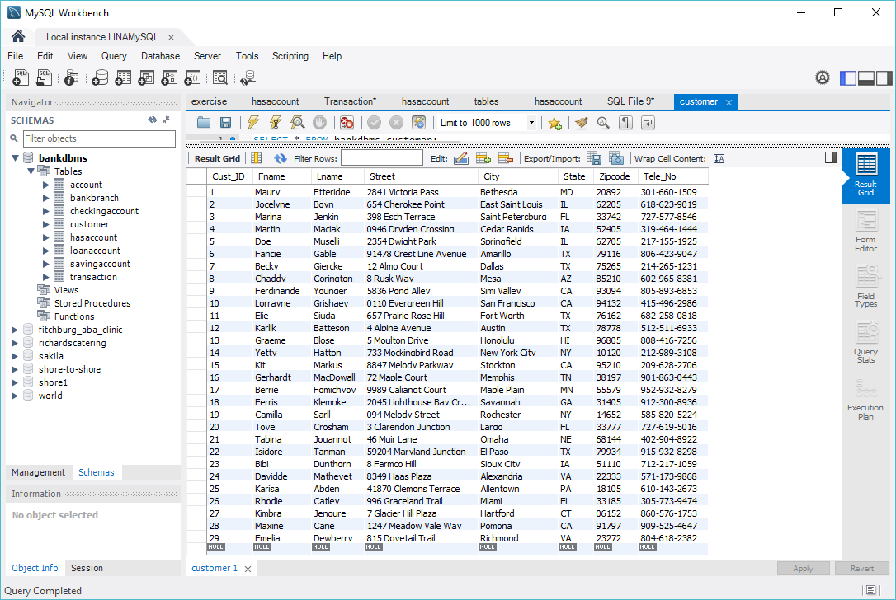
Drop customer
Result customer table

Slide 17
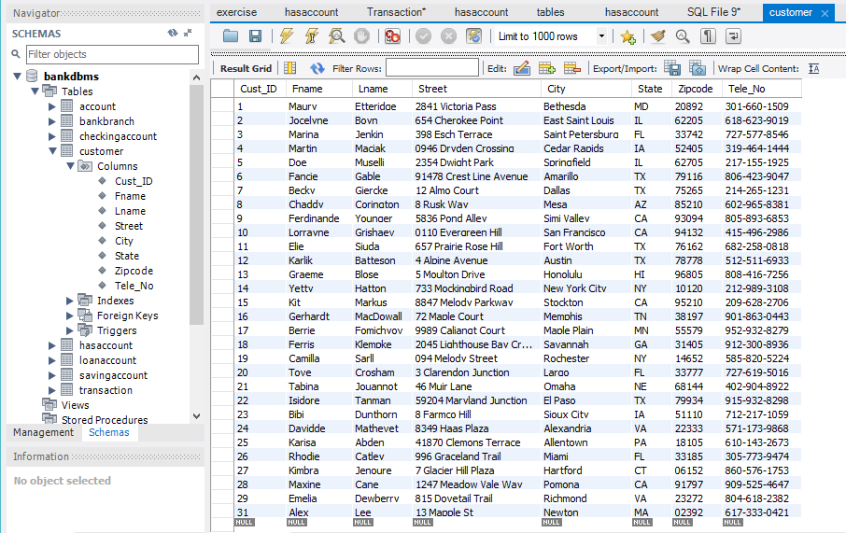
Add customer
Query: insert into customer(fname, lname, Street, City, State, Zipcode, Tele_No) values ('Alex','Lee','13 Mapple St', 'Newton', 'MA', '02392','617-333-0421');

Slide 18
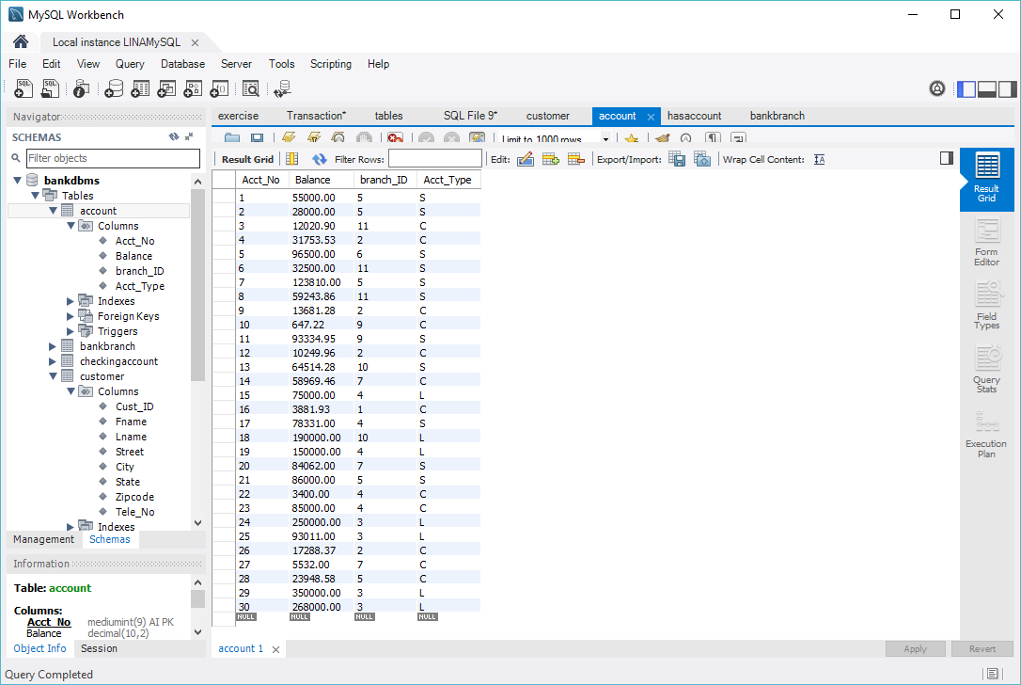
Open Account
Query: insert into account(Acct_No, Balance, Branch_ID, Acct_Type) values(31, 8300, 3, 'C');
insert into hasaccount(Cust_ID, Acct_No, Open_Date) values(29, 31, '2017-05-24');
Original account table

Slide 19
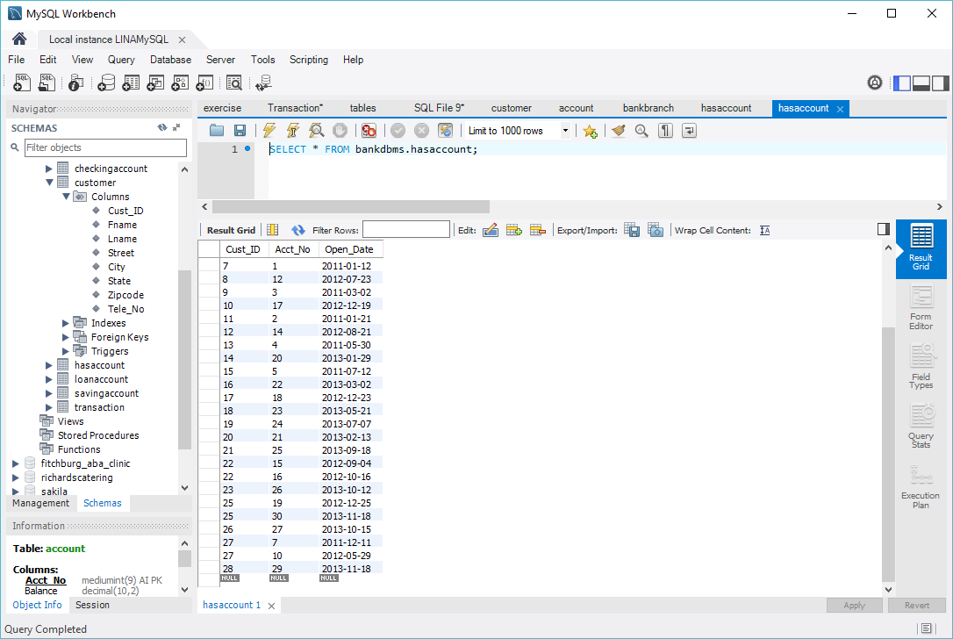
Open Account
Original hasaccount table

Slide 20
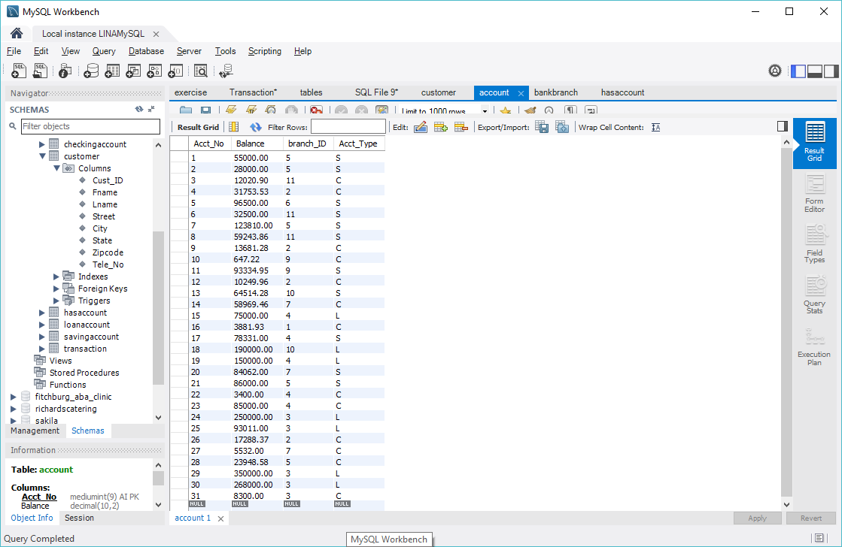
Open Account
Result account table

Slide 21
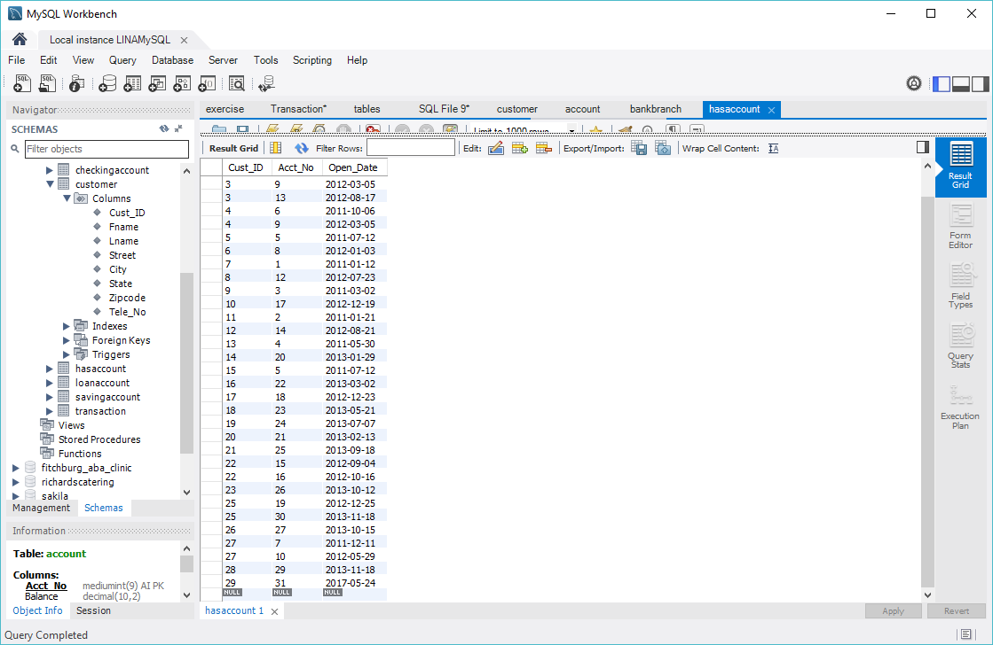
Open Account
Result hasaccount table

Slide 22
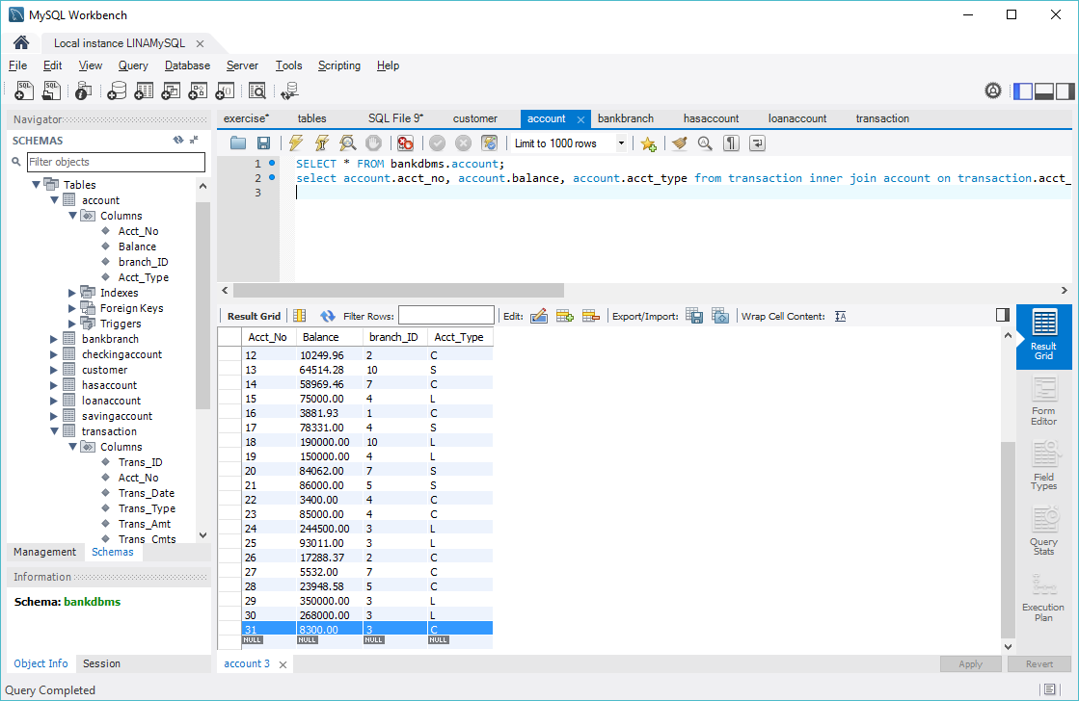
Close an Account
Queries: delete from account where Acct_No=31;
delete from hasaccount where cust_ID=29 and acct_No=31;

Slide 23
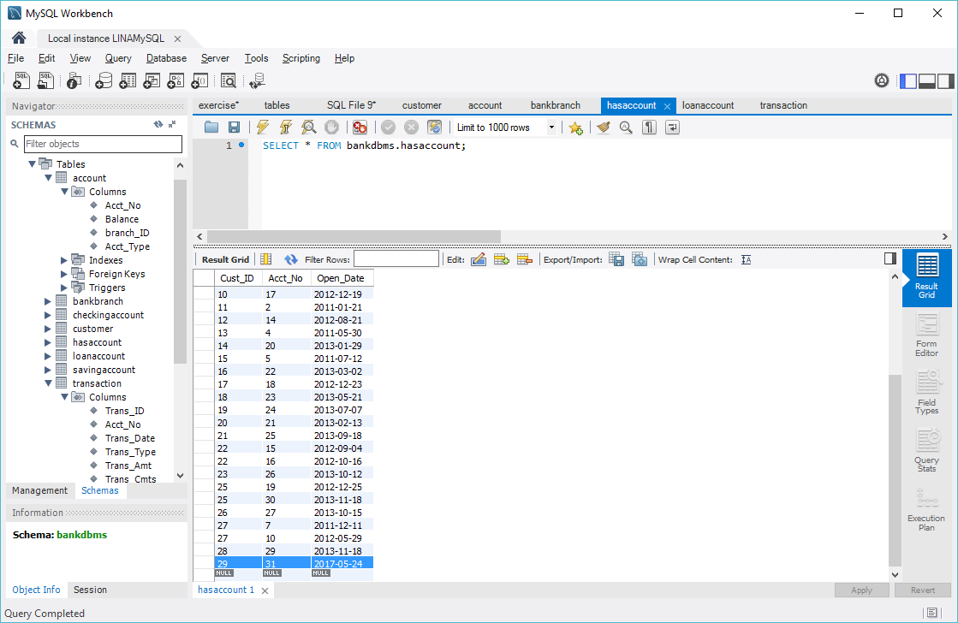
Close an Account
Original hasaccount table

Slide 24
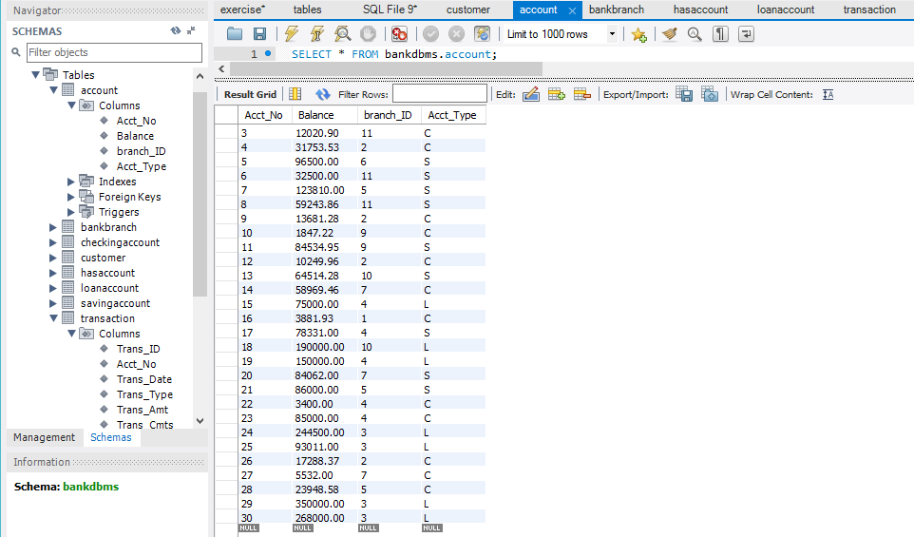
Close an Account
Result account table

Slide 25
Close an Account
Result hasaccount table

Slide 26
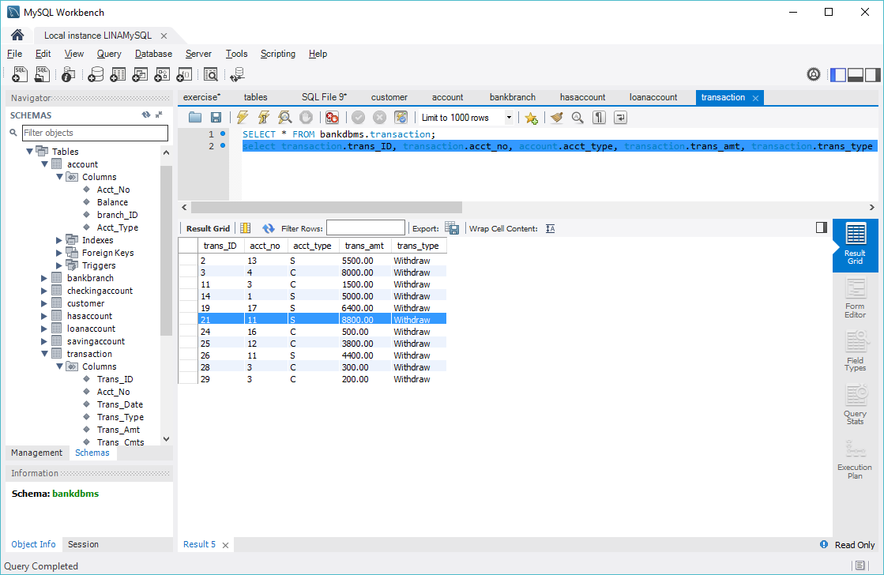
Withdraw transaction
Queries: 1) select account.acct_no,account.balance-transaction.trans_amt as newbalance from transaction inner join account on transaction.Acct_No=account.Acct_No and transaction.Trans_ID=21;
2)update account set balance=84534.95 where account.Acct_No=11;

Slide 27
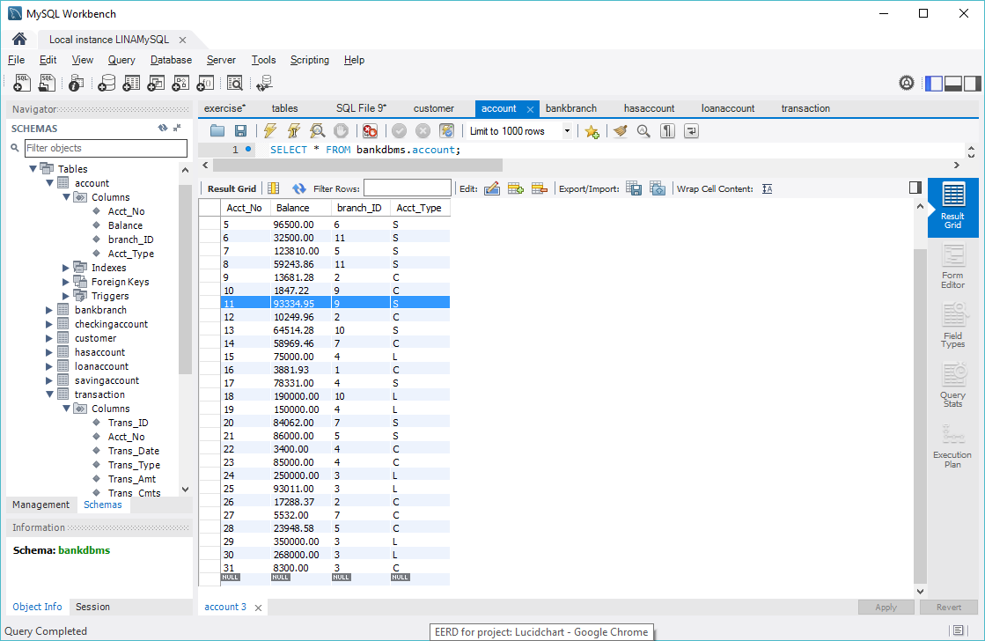
Withdraw transaction
before

Slide 28
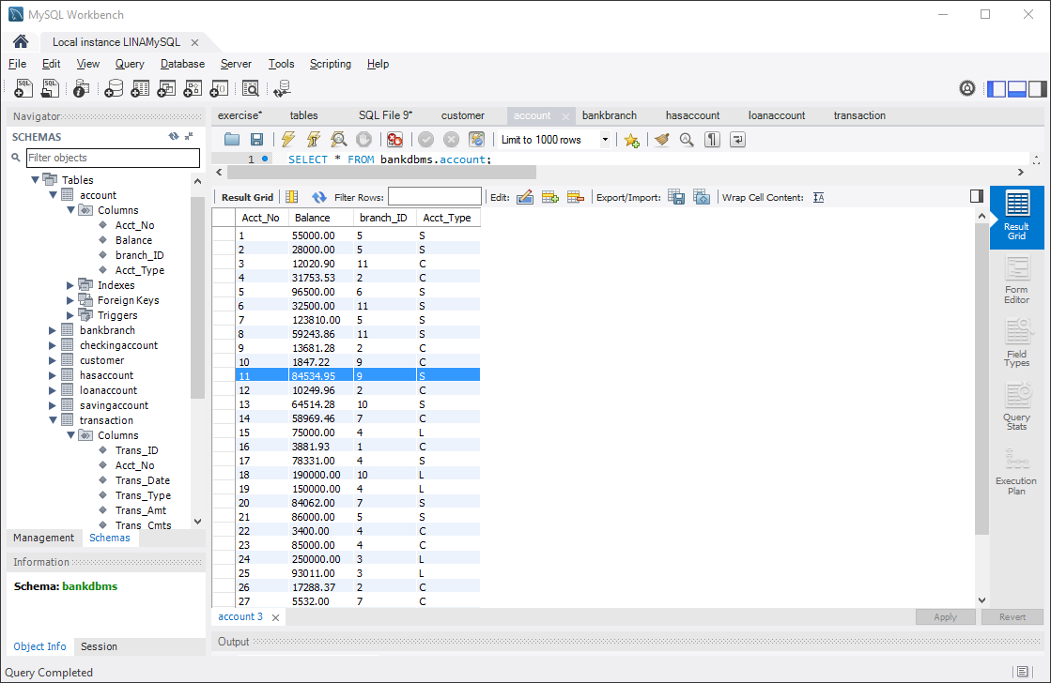
Withdraw transaction
After

Slide 29
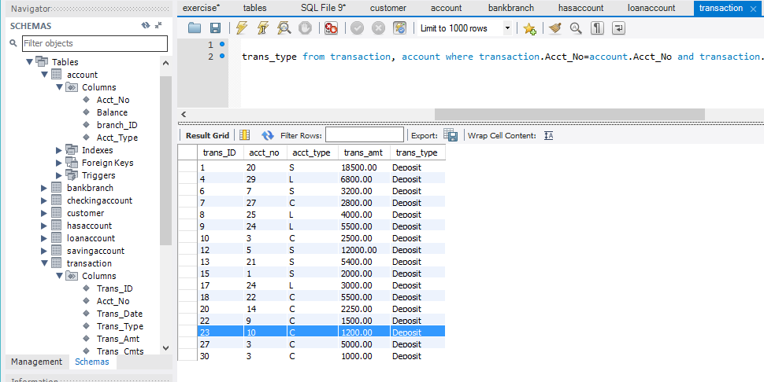
Deposit Transaction
Queries
select account.acct_no, account.Balance+transaction.Trans_Amt as newbalance
from transaction, account
where transaction.acct_no=account.acct_no and transaction.trans_id=23;
update account set balance=1847.22 where acct_no=10;

Slide 30
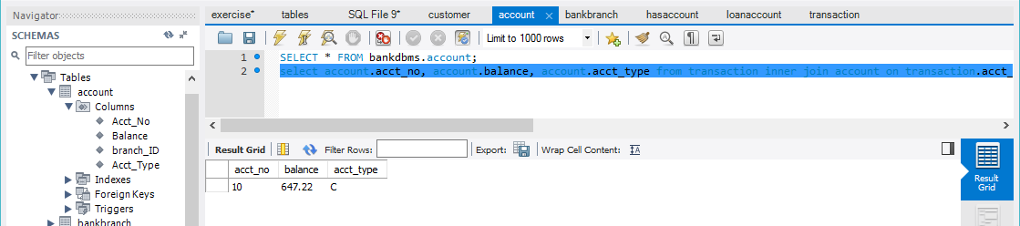
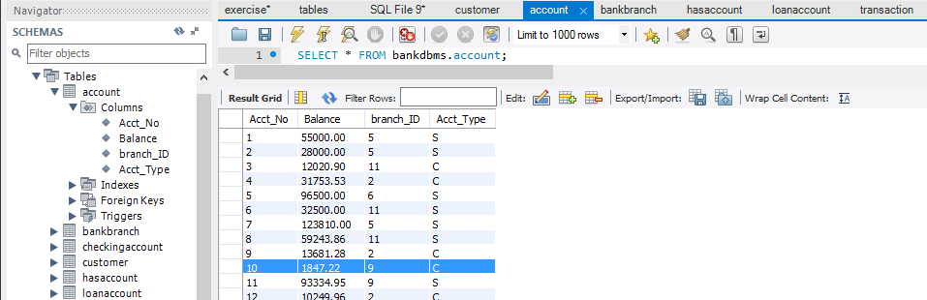
Deposit Transaction
Before:
After:

Slide 31
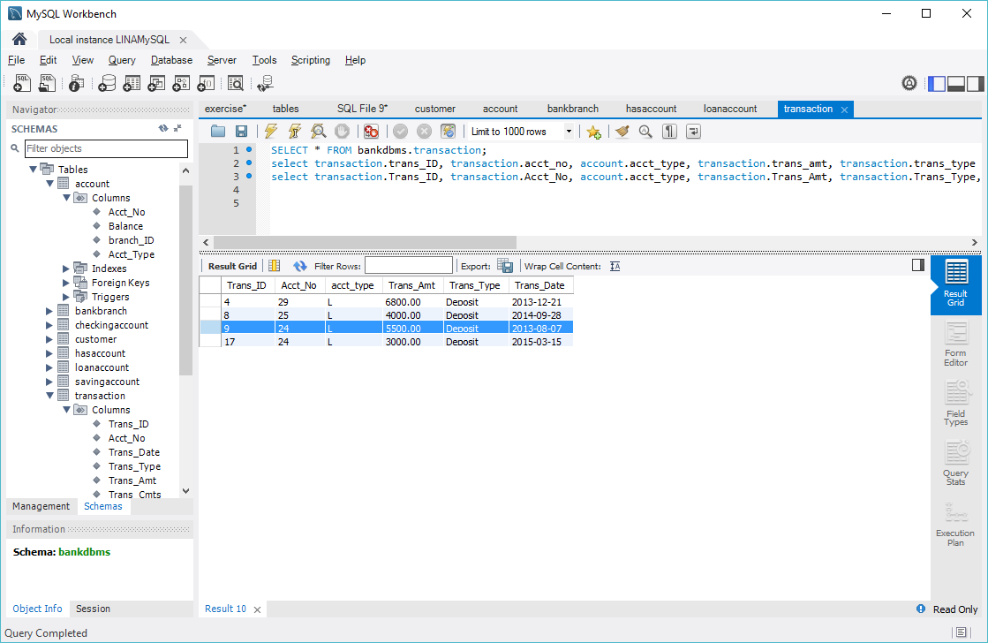
Loan Payment Transaction
Queries:
select account.acct_no, account.balance-transaction.Trans_Amt as newbalance from transaction inner join account on transaction.acct_no=account.acct_no and transaction.trans_ID=9;
2)update account set balance=244500.00 where acct_no=24

Slide 32
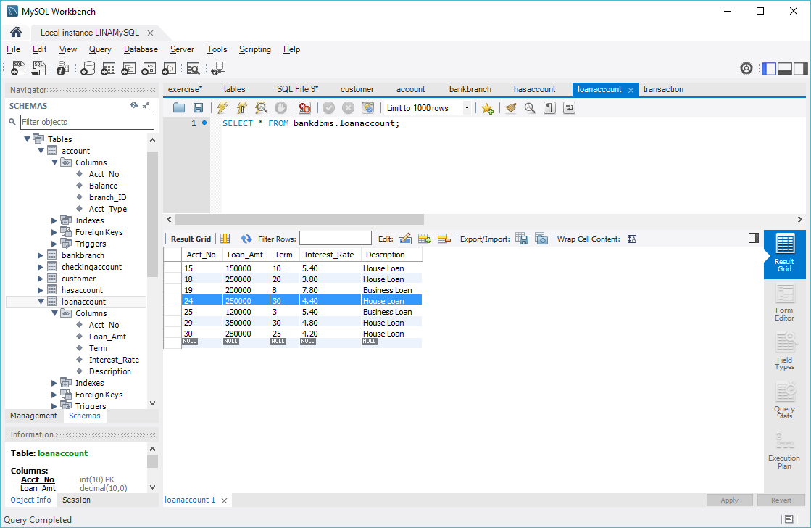
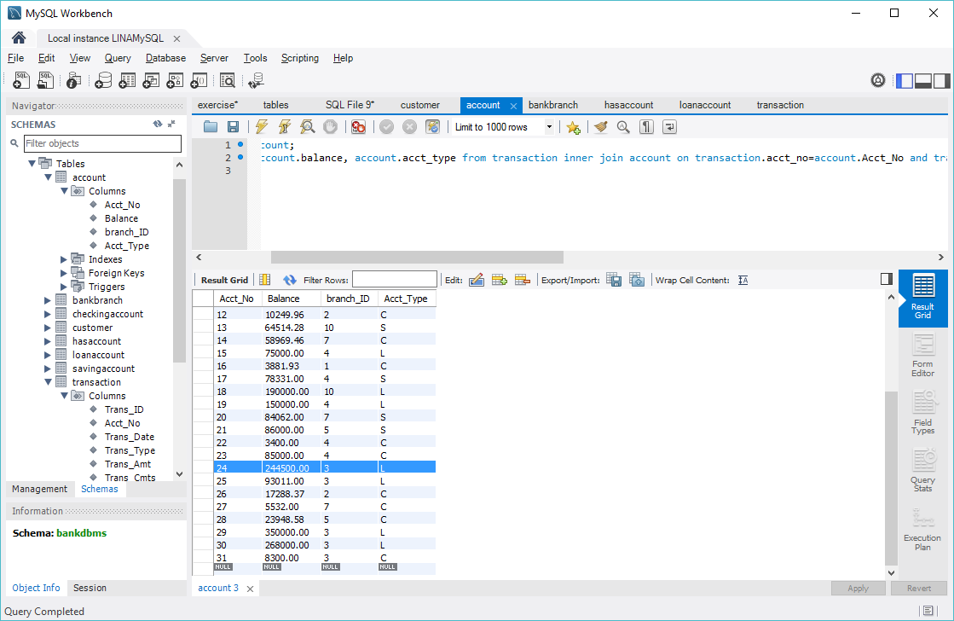
Loan Payment Transaction
Before:
After:

Slide 33
Make loan payment schedule
Query: select customer.cust_ID, customer.fname, customer.lname, account.acct_no, loanaccount.loan_amt, loanaccount.term, loanaccount.interest_rate, loanaccount.loan_amt*pow((1+loanaccount.interest_rate*0.01),loanaccount.term)/(loanaccount.term*12) as monthlypayment
from customer inner join hasaccount on customer.cust_id=hasaccount.cust_id
inner join account on hasaccount.acct_no=account.acct_no
inner join loanaccount where loanaccount.acct_no=account.acct_no and loanaccount.acct_no=24;

Slide 34
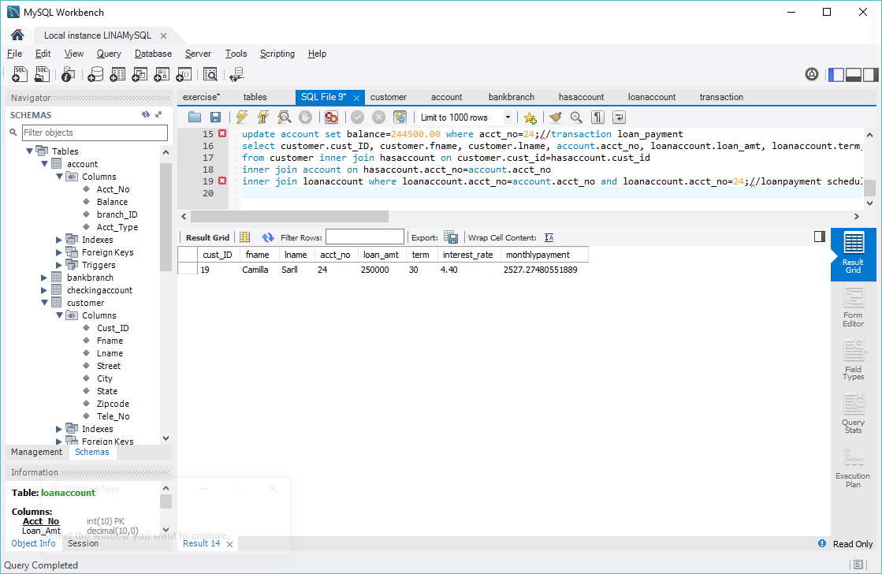
Make loan payment schedule
Result:

Slide 35
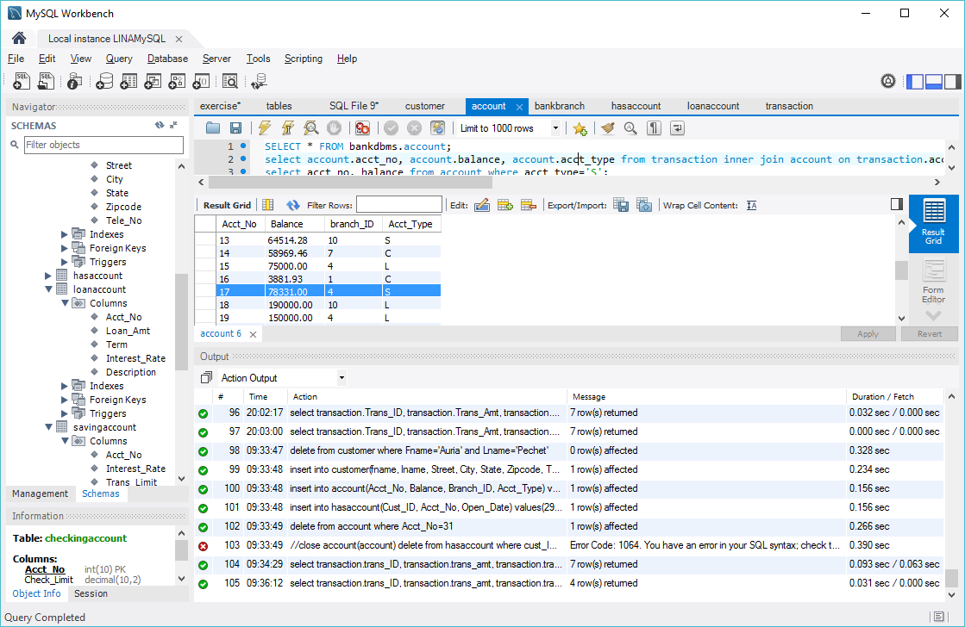
Calculate yearly interest
Queries
select account.acct_no, account.balance, savingaccount.interest_rate, account.balance*savingaccount.interest_rate*0.01 as yearlyinterest
from account inner join savingaccount on account.acct_no=savingaccount.acct_no and account.acct_no=17;

Slide 36
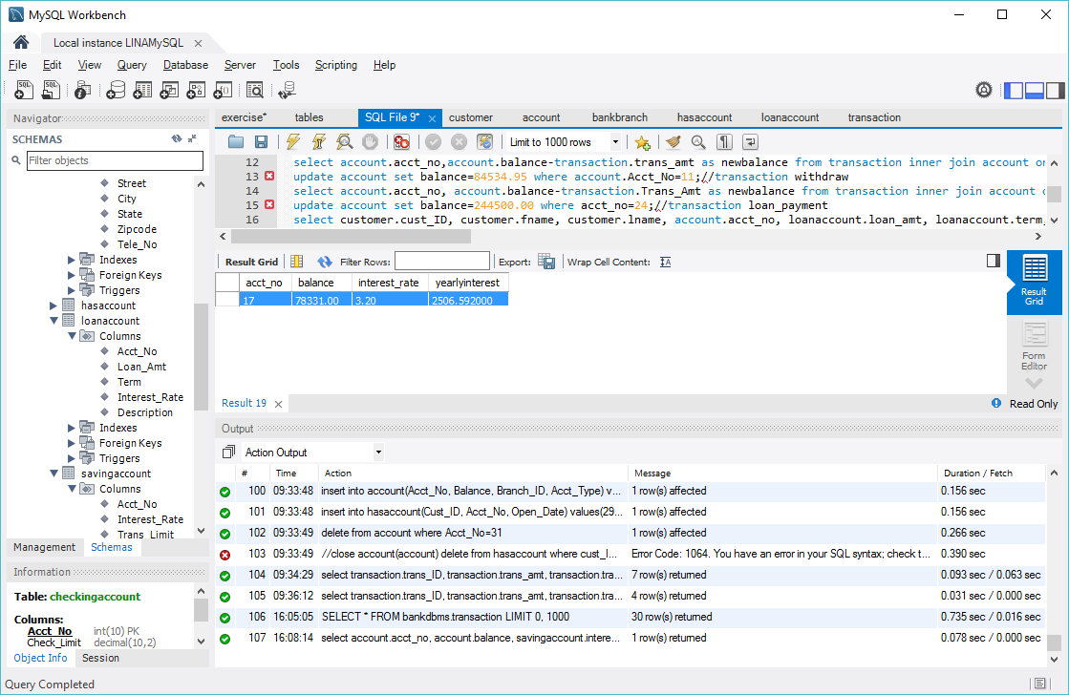
Calculate yearly interest
result

Slide 37
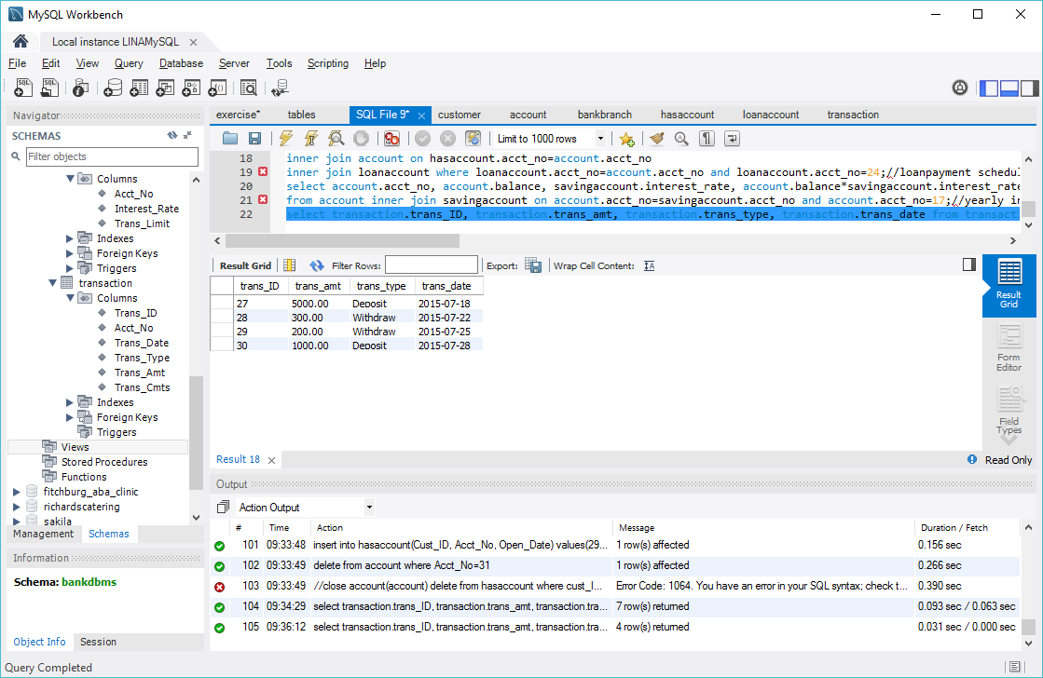
monthly transactions of an account
Queries
select transaction.trans_ID, transaction.trans_amt, transaction.trans_type, transaction.trans_date from customer inner join hasaccount on customer.Cust_ID=hasaccount.Cust_ID and customer.lname='Younger'
inner join account on hasaccount.Acct_No=account.Acct_No
inner join transaction on transaction.acct_no=account.acct_no and transaction.trans_date>'2015-07-01' and transaction.trans_date<'2015-07-31'

Slide 38
Conclusion
A bank DBMS with eight entities is designed
The EERD, conceptual design and physical design of the bank DBMS are described
The basic functions (withdraw/deposit/transfer, open/close account, add/drop customer) are succeffully implemented
Further work: customer-friendly interface need to be designed to collect data and information

